Slide 1

NN & Optimization
Yue Wu

Slide 2

Questions?

Slide 3
Back Prop (Isn’t This Trivial?)
When I first understood what backpropagation was, my reaction was: “Oh, that’s just the chain rule! How did it take us so long to figure out?” I’m not the only one who’s had that reaction. It’s true that if you ask “is there a smart way to calculate derivatives in feedforward neural networks?” the answer isn’t that difficult.
But I think it was much more difficult than it might seem. You see, at the time backpropagation was invented, people weren’t very focused on the feedforward neural networks that we study. It also wasn’t obvious that derivatives were the right way to train them. Those are only obvious once you realize you can quickly calculate derivatives. There was a circular dependency.

Slide 4
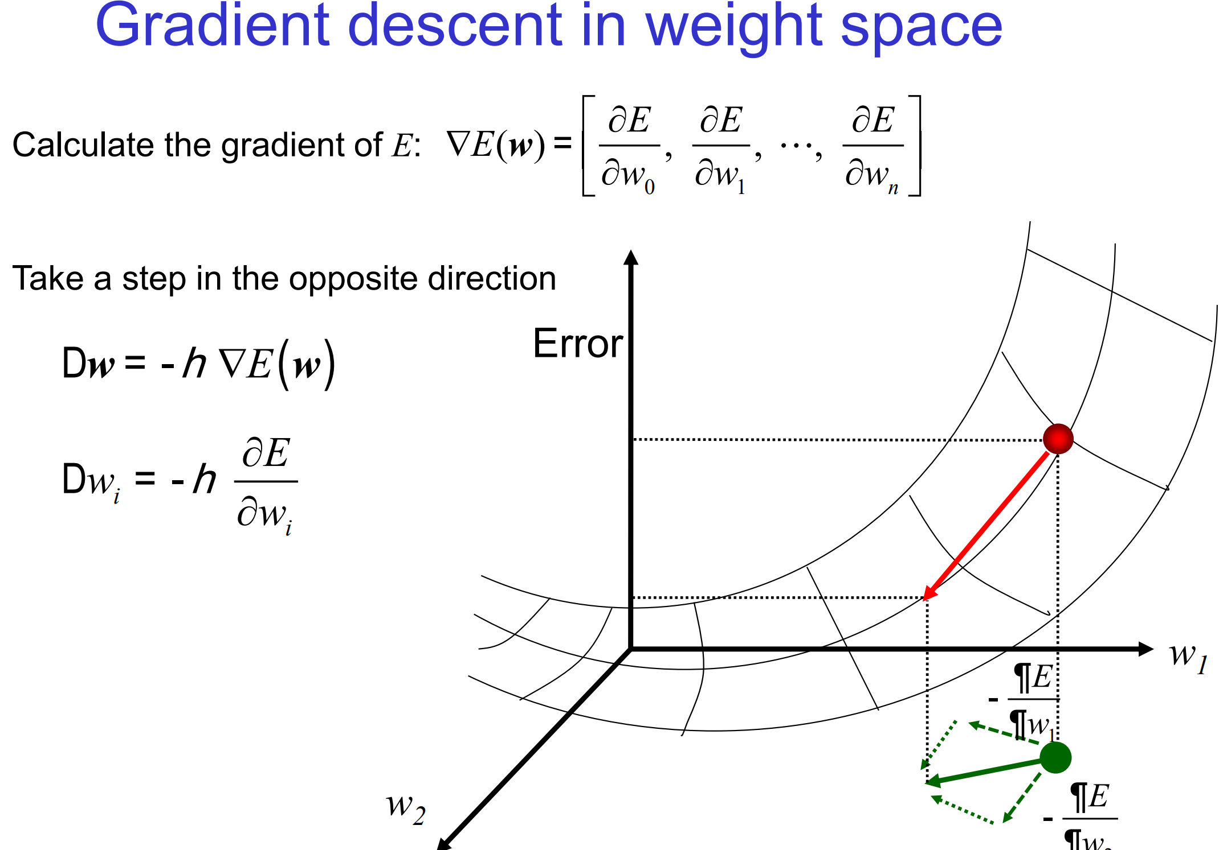
Gradient Descent

Slide 5
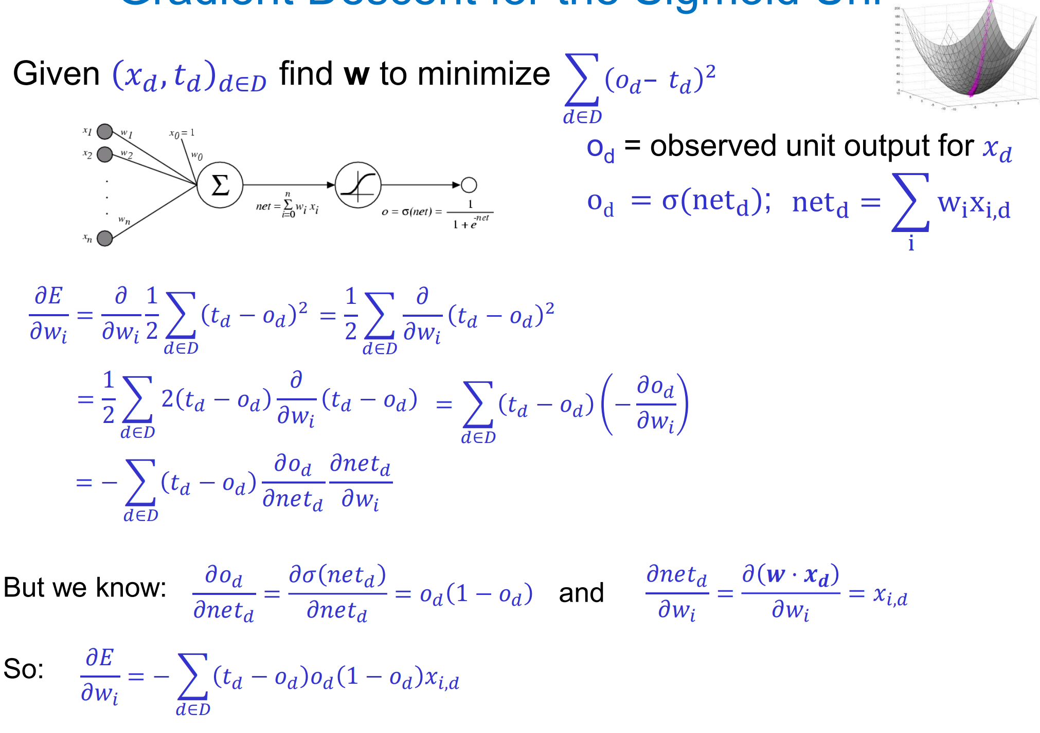
Backprop for Sigmoid

Slide 6
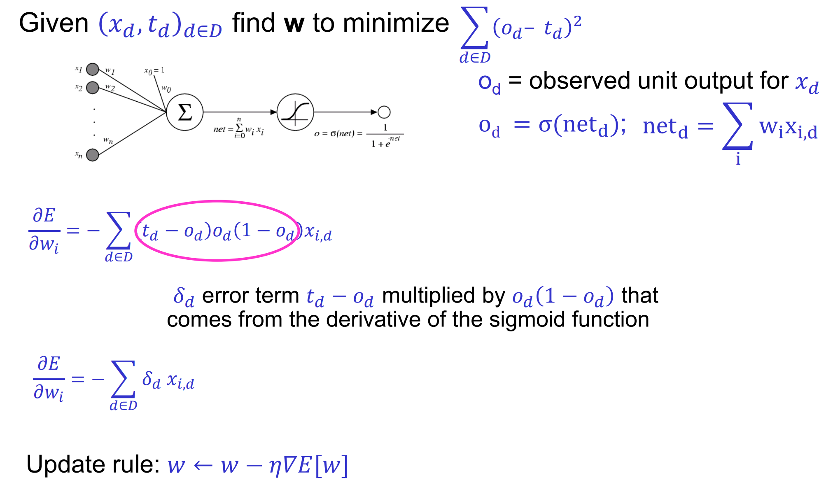

Slide 7
Computation Graphs
Towards Auto-differentiation
(Autograd)

Slide 8
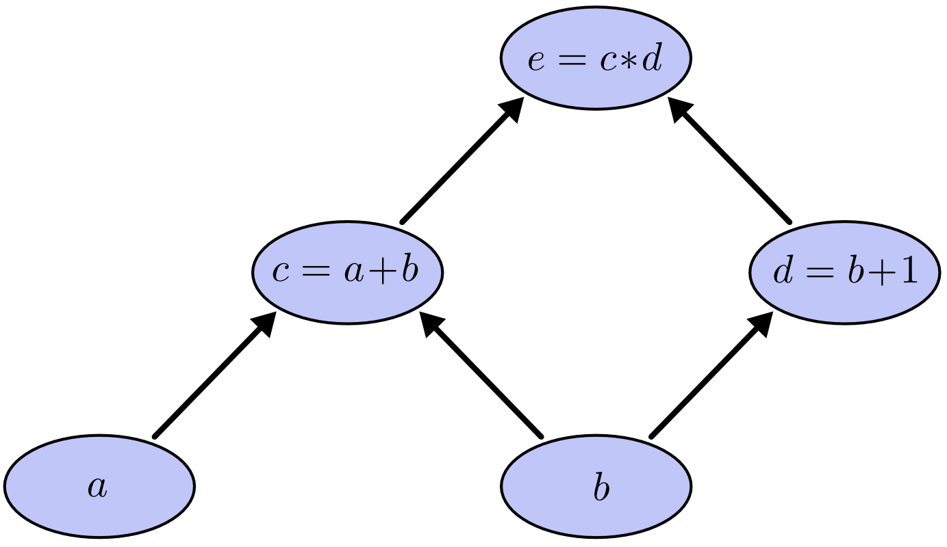
Suppose we

Slide 9
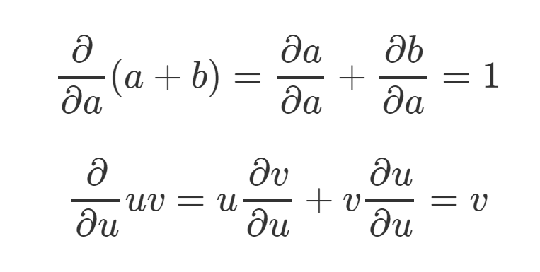

Slide 10
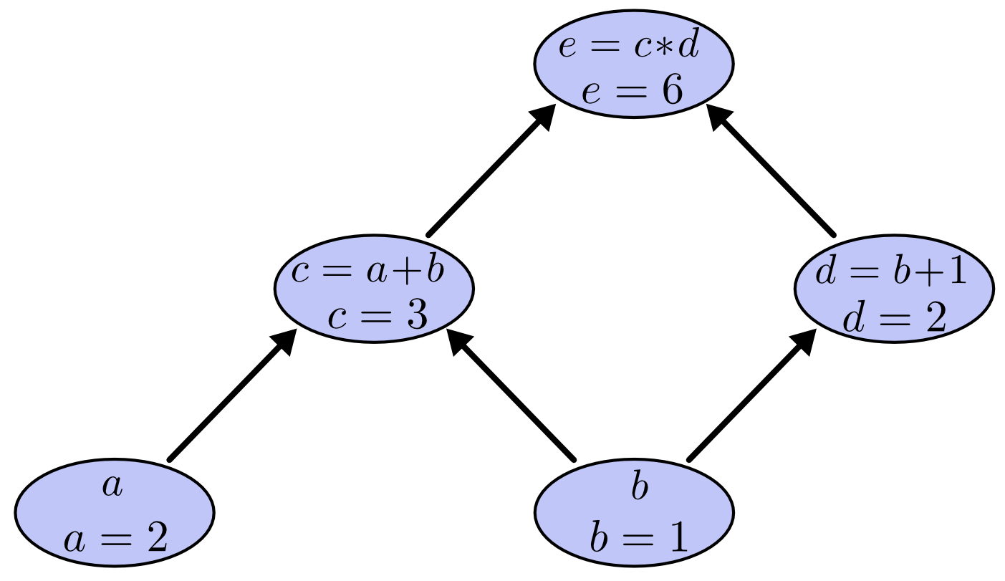

Slide 11
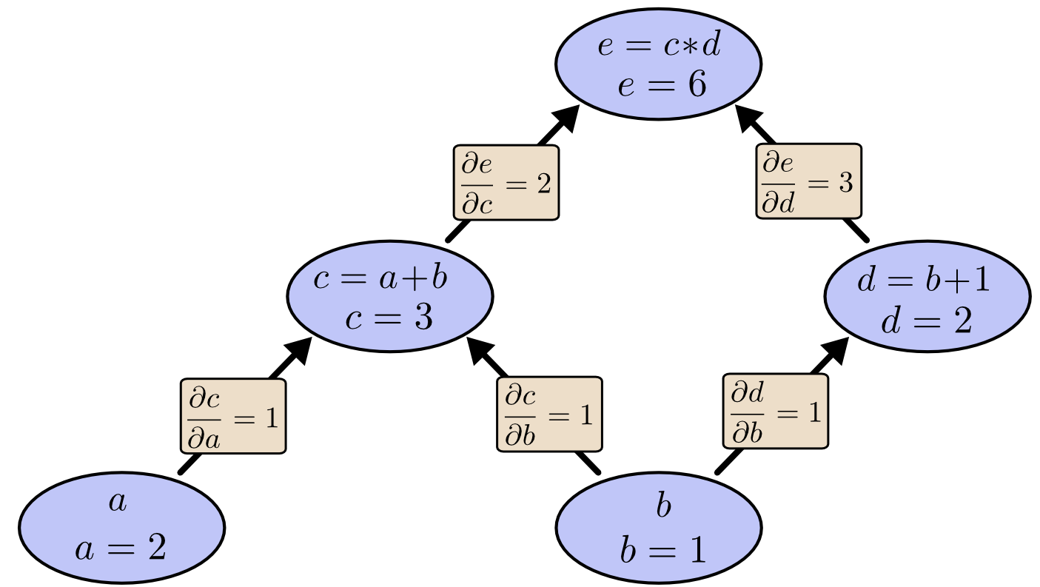

Slide 12
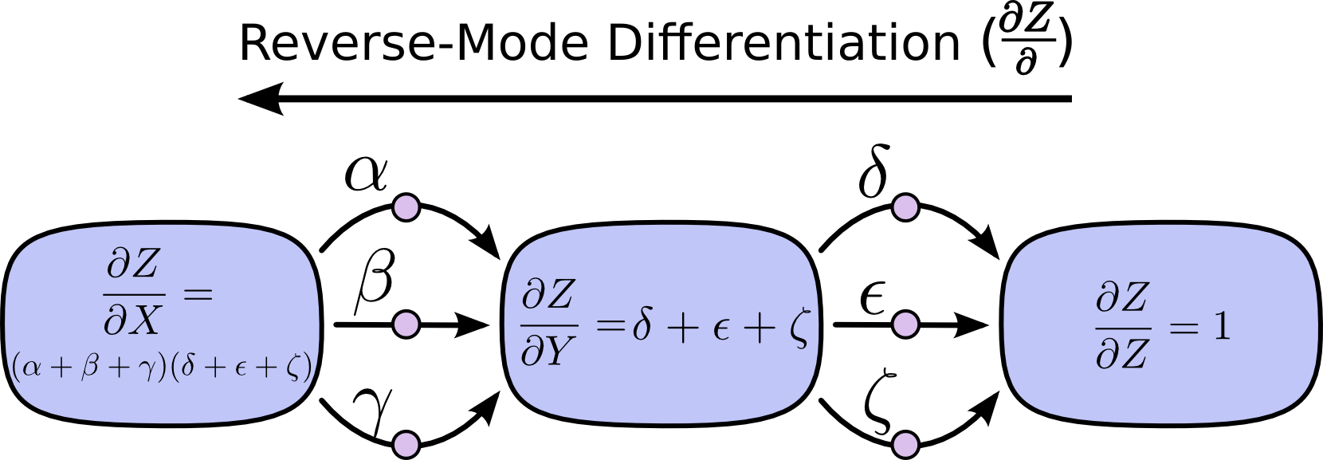

Slide 13
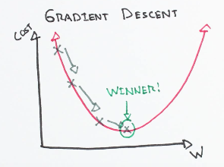
Gradient Descent

Slide 14
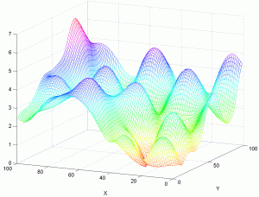

Slide 15
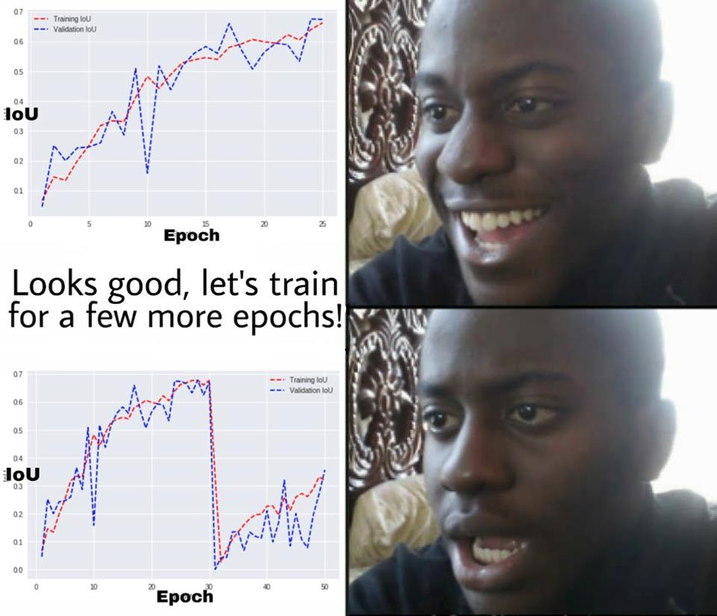
Does it work?

Slide 16
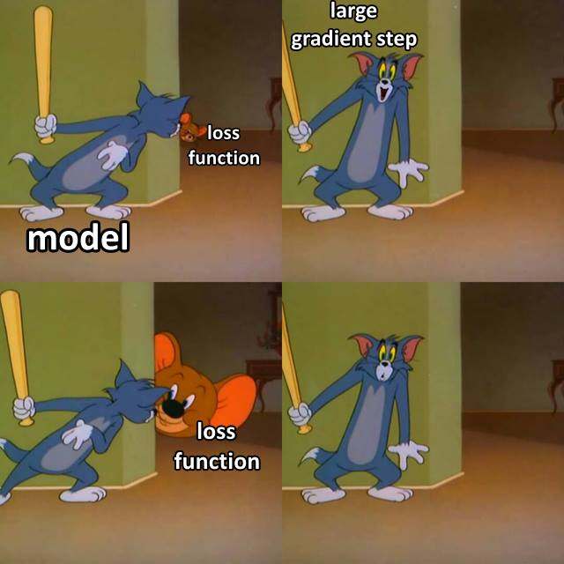
Gradient!!!

Slide 17
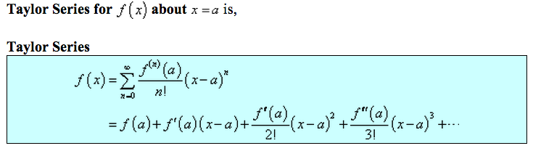
Why Doesn’t Gradient Tell You Everything

Slide 18
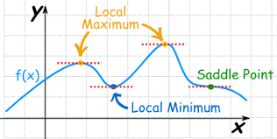
Local Min & Saddle Points!

Slide 19
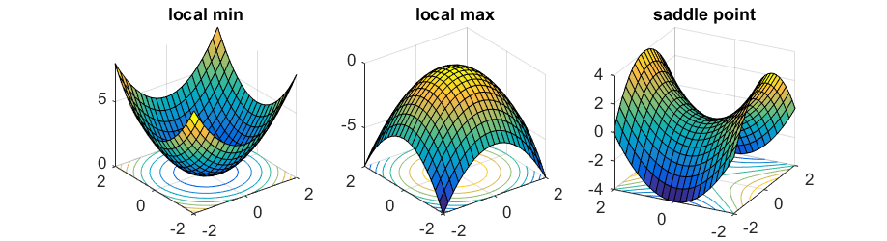
Saddle Point

Slide 20
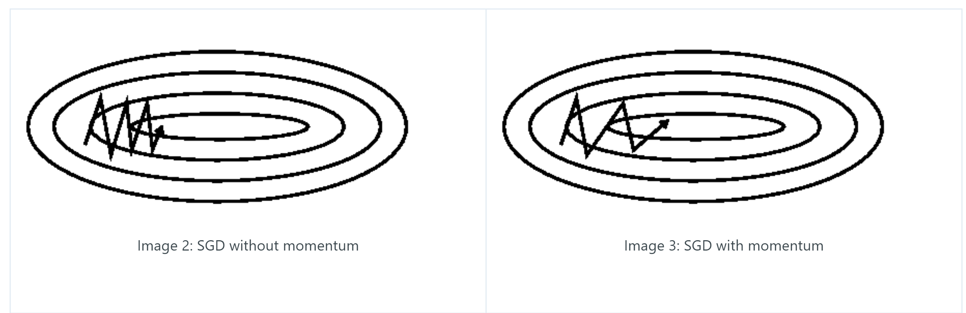
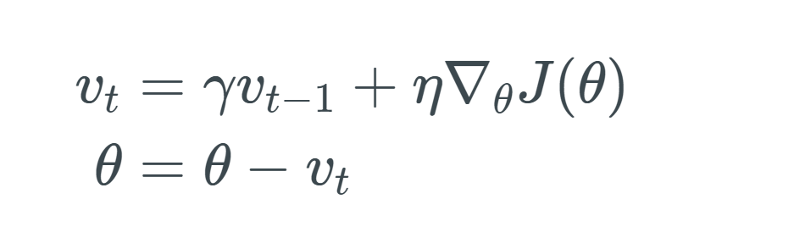
Momentum

Slide 21
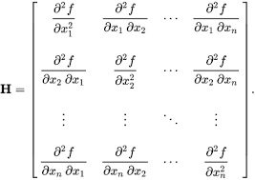
Hessian Matrix

Slide 22

Hessian Free Optimization Methods

Slide 23
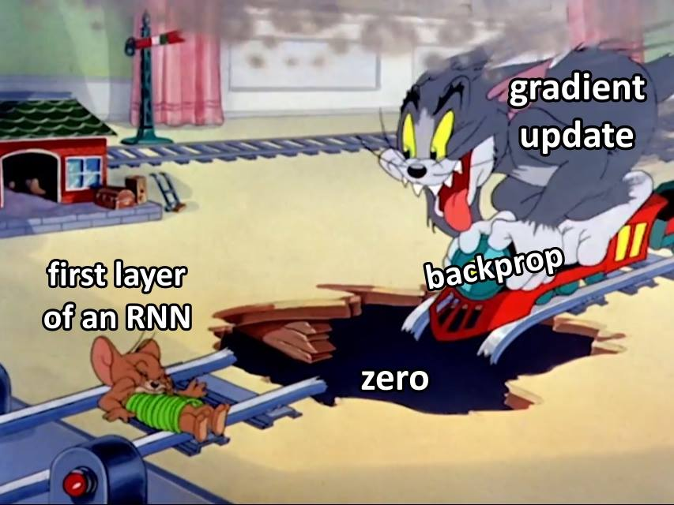
Vanishing & Exploding GRADIENT!

Slide 24
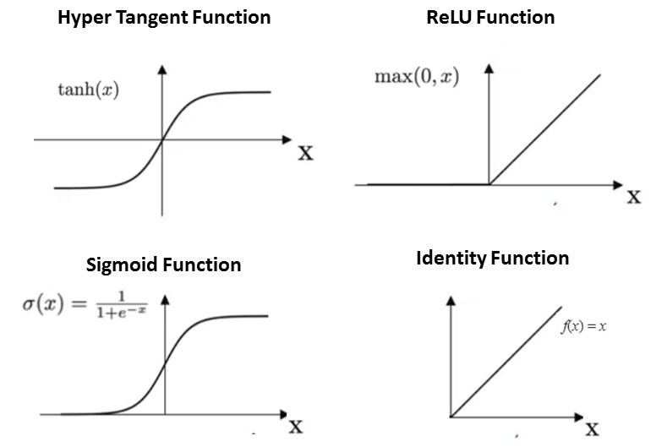

Slide 25
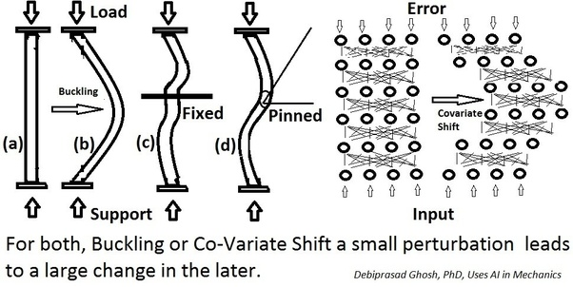
Covariant Shift (BatchNorm)

Slide 26
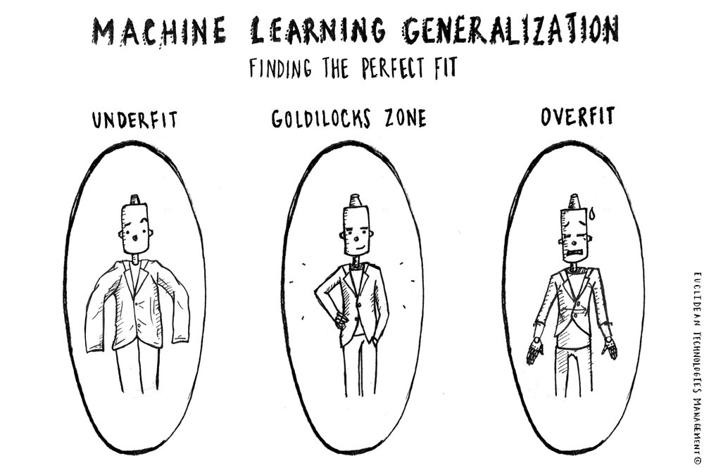

Slide 27

GET MORE DATA!!!!

Slide 28
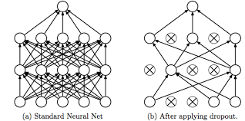
Dropout

